Slide 1




Web Design Tools
The tools we need
HTML5
Telerik Software Academy
http://academy.telerik.com

Slide 2
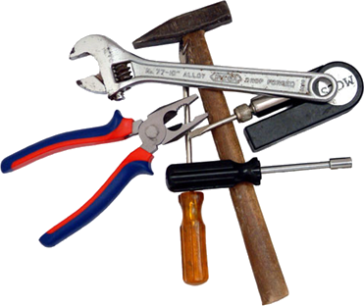

Table of Contents
Coding tools
IDEs
Lite tools
Drawing and Slicing tools
Browsers and browser tools
Source control tools

Slide 3



Coding Tools

Slide 4



IDEs
MS Visual Studio/MS Visual Web Developer
MS Web Matrix
Eclipse/Aptana
JetBrains WebStorm
Sublime Text 2/3
Adobe Brackets

Slide 5


Lite tools
Notepad++
GEdit

Slide 6
Browsers and Browser Tools
Browsers
Internet Explorer
Google Chrome
Mozilla Firefox
Apple Safari
Opera
Browser Tools
Firebug
WebInspector
WebDeveloper Toolbar
F12 (IE)
Inspect
Console
Bookmarklets

Slide 7



Drawing and Slicing Tools
Adobe Photoshop
Adobe Fireworks
Gimp
Paint.NET

Slide 8


Source control tools
Microsoft TFS, Microsoft VSS
Git
SVN

Slide 9
Web Design Tools
?
?
?
?
?
Questions?
?
?
?
?
?
http://academy.telerik.com

Slide 10




Free Trainings @ Telerik Academy
"Web Design with HTML5, CSS3 and JavaScript" course @ Telerik Academy
html5course.telerik.com
Telerik Software Academy
academy.telerik.com
Telerik Academy @ Facebook
facebook.com/TelerikAcademy
Telerik Software Academy Forums
forums.academy.telerik.com

